Slide 1
Data Engineering
Episode 1
Overview and Relational Data Modeling

Slide 2
Overview
Data Engineering - What is it? Why learn about it?
Relational Databases
Relational Data Modeling
What is data modeling
Normalization
Denormalization
Facts & Dimensions
Analysis & the Star Schema
Sparkify ETL Demo
Questions?

Slide 3
Data Engineering - What is it? Why learn about it?
What is it?
Any processing of data needed to take if from its source to make it available to users
Historically was focused on analytic teams, but now it moving more into the software engineering realm
Evolution - https://medium.com/analytics-and-data/on-the-evolution-of-data-engineering-c5e56d273e37
Why Learn about it?
As we move towards more demand for data, specialized knowledge will be needed to handle it effectively
Also It’s kinda my job, got really interested after talking with USCC
Where does it fit at TDS
Critical to business operations because we as a company need to be able to answer data-driven analytical questions efficiently, accurately, and consistently
Why this program?
I like a project focus, as it’s more like work and less like going to college
Notes:
OLTP vs OLAP

Slide 4
Technologies
(Data Processing has a lot of them)
Relational DBs - Postgres
NoSQL DBs - Cassandra (distributed partitions)
Redshift (aka AWS Data Warehouse)
Spark (Distributed Processing)
AirFlow (DAG)
Tool Lanscape https://datafloq.com/big-data-open-source-tools/os-home/

Slide 5
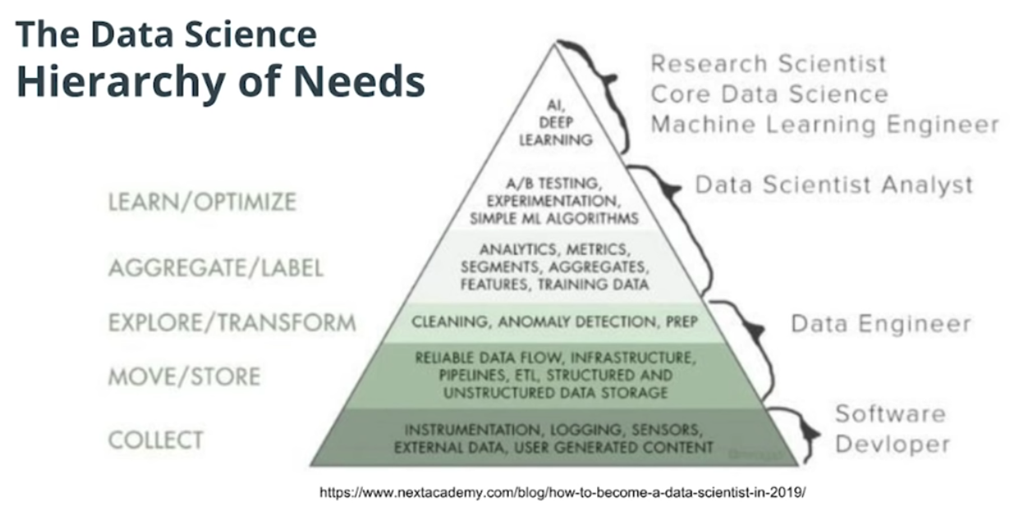
Data Engineering in Pictures
Data Needs
Notes:
Effectively it lives between application systems and analysts

Slide 6
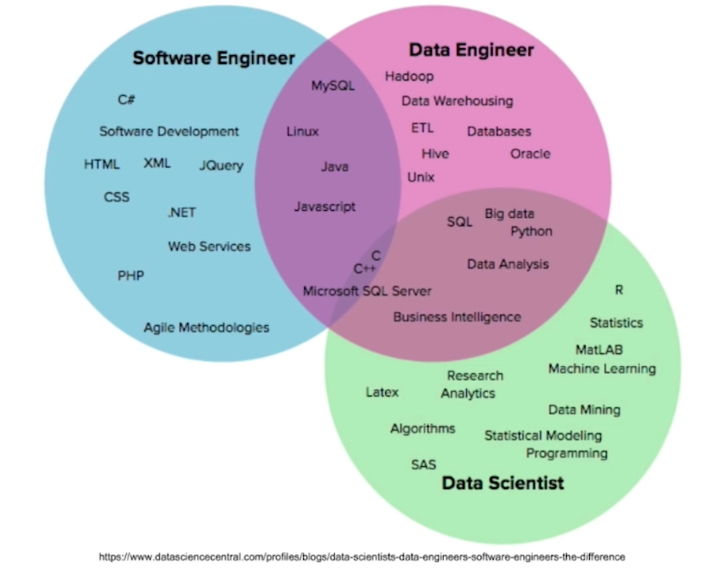
Data Engineering in Pictures
Venn DIagrams

Slide 7
What is Data Modeling?
Anytime you decide how to store data you are modeling it
Can be simple - deciding what column labels to use in Excel
Can be more complex - Distributed Systems, Pipelines etc

Slide 8
Relational Databases in 2 minutes
Developed in the 50’s by IBM, became poplar in the 80’s – Oracle V2 1979
Relations (tables) and Relationships between them
Enforcement of keys
Advantages of Using a Relational Database
Flexibility for writing in SQL queries: With SQL being the most common database query language.
Modeling the data not modeling queries
Ability to do JOINS
Ability to do aggregations and analytics
Secondary Indexes available : You have the advantage of being able to add another index to help with quick searching.
Smaller data volumes: If you have a smaller data volume (and not big data) you can use a relational database for its simplicity.
ACID Transactions: Allows you to meet a set of properties of database transactions intended to guarantee validity even in the event of errors, power failures, and thus maintain data integrity.
Easier to change to business requirements
Notes:
Atomicity: The whole transaction is processed or nothing is processed. A commonly cited example of an atomic transaction is money transactions between two bank accounts. The transaction of transferring money from one account to the other is made up of two operations. First, you have to withdraw money in one account, and second you have to save the withdrawn money to the second account. An atomic transaction , i.e., when either all operations occur or nothing occurs, keeps the database in a consistent state. This ensures that if either of those two operations (withdrawing money from 1st account and saving the money to the 2nd account) fail, the money is neither lost nor created. Source Wikipedia
Consistency: Only transactions that abide by constraints and rules are written into the database otherwise the database keeps the previous state. The data should be correct across all rows and tables. Check out additional information about consistency on Wikipedia.
Isolation: Transactions are processed independently and securely, order does not matter. A low level of isolation enables many users to access the data simultaneously, however this also increases the possibilities of concurrency effects (e.g., dirty reads or lost updates). On the other hand, a high level of isolation reduces these chances of concurrency effects, but also uses more system resources and transactions blocking each other. Source: Wikipedia
Durability: Completed transactions are saved to database even of cases of system failure. A commonly cited example includes tracking flight seat bookings. So once the flight booking records a confirmed seat booking, the seat remains booked even if a system failure occurs. Source: Wikipedia.

Slide 9
Normalization
Normalization
Removing redundancy to make the system more efficient for writes
Tuning the system to support the business process (Transaction Processing)
A Ticket
A Sale
A Dispatch
A Website Login

Slide 10
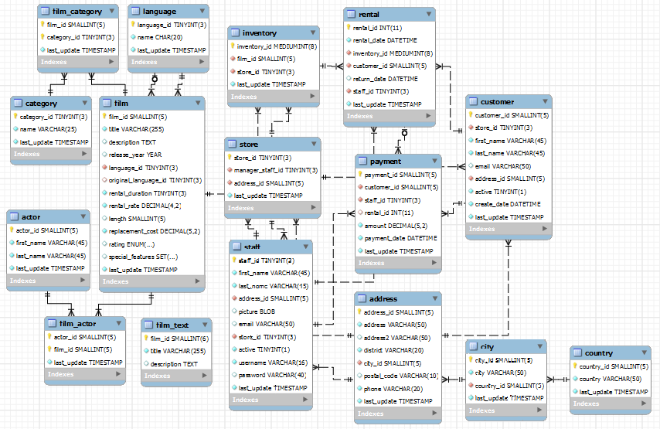
What does a Normalized Schema look like?
(Salkia Example Schema)

Slide 11
Denormalization
Denormalization
Must happen after normalization
Prioritizes Reads
Fact and Dimensions
Facts - Measurable, additive, always true (a sale, a call, a network usage metric)
Dimensions - Categorical (can also be chained) and designed to be updated in place
Star Schema

Slide 12
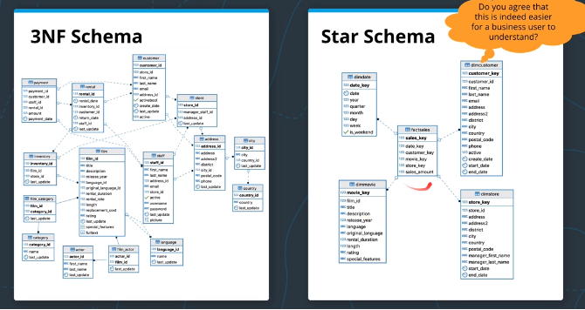
Denormalizing For Analytics

Slide 13
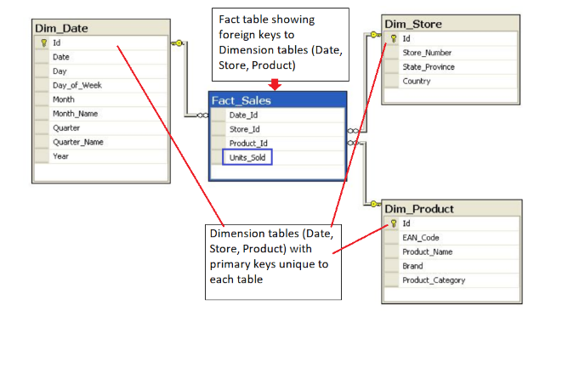
Star Schema

Slide 14
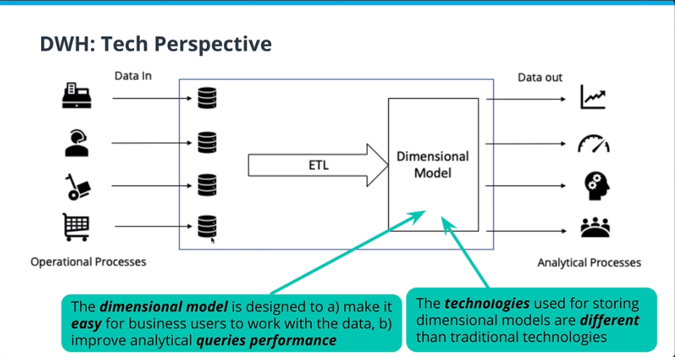
What is ETL?

Slide 15
Demo Time
Project is for a streaming company called Sparkify that wants to understand customer behavior in their streaming app
Input
Log files - customer actions, dates etc
Music files - Information on the songs and artists
Output
Star scheama
Facts - Slong Play
Dimensions
Artist
Song
Time
User

Slide 16
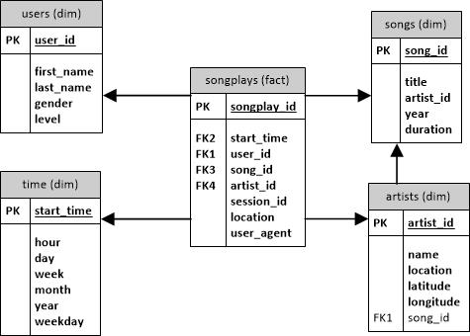
Table Schema

Slide 17
Questions….
Demo Sample Files - https://github.com/JayMadison/Module1_Data_Modeling
Notes - https://github.com/JayMadison/Data_Engineering_Notes

